Slide 1
Advanced Databases Lecture 11: MongoDB part 2
Dr. Pierpaolo Dondio,
DT228 - ASD

Slide 2
To go
Week 12 Monday – Lecture on MongoDB
Week 12 Monday – Lecture on Neo4J + Exam paper
Week 12 Wed Lab – MongoDB lab 2
Week 13 Wed Lab – Finilising Lab work
Week 14 – Lab Work Demo 2 (10%)
Lab Week 8 (dimensional model)
Lab Week 9 (“golf” ETL)
Mongodb lab 2
Assignment: 4th of January (20%)
Exam: Friday January 15th 1:00pm – 3:00pm (60%)

Slide 3
So Far
Schemaless (JSON/BSON)
Embedded JSON
Simple queries
Aggregation built-in operators
MapReduce used to perform complex queries
(Java)script for MongoDB

Slide 4
Output from a shell
Some practical tips
When running from a script:
Output of a query is not displayed by default, use the following function to display it.
function get_results (result)
{ print(tojson(result)); }
db.col.find(…).forEach(get_results)

Slide 5
Documents Update
MongoDB does not allow to update a field by using an expression containing other fields of the collections
Therefore, you cannot write $field = $field + 1 or something similar (as we did for SQL)
For numeric update, use the $inc operator with updatefunction
Or.. Javascript always an option!
Example:
{ _id: 1, item: "abc123", quantity: 10, metrics: { orders: 2, ratings: 3.5 } }
db.products.update( { item: "abc123" }, { $inc: { quantity: -2, "metrics.orders": 1 } } )

Slide 6
Multiple Updates
Add {multi: true). It controls the ability of mongoDB to update more than one field in a single query
Try:
> db.pierpaolo.update({first: { $ne: "aa"} },{ $inc: {age : 2}})
WriteResult({ "nMatched" : 1, "nUpserted" : 0, "nModified" : 1 })
> db.pierpaolo.update({first: { $ne: "aa"} },{ $inc: {age : 2}},{multi: true})
WriteResult({ "nMatched" : 7, "nUpserted" : 0, "nModified" : 7 })

Slide 7
Cursors
var myCursor = db.inventory.find( { type: 'food' } );
while (myCursor.hasNext()) { print(tojson(myCursor.next())); }
myCursor.forEach(printjson);
var documentArray = myCursor.toArray();
var myDocument = documentArray[3];
var myDocument = myCursor[3];

Slide 8
Shell – Script Commands
SHELL show dbs, show databases | JS SCRIPT db.adminCommand('listDatabases')
use <db> | db = db.getSiblingDB('<db>')
show collections | db.getCollectionNames()

Slide 9
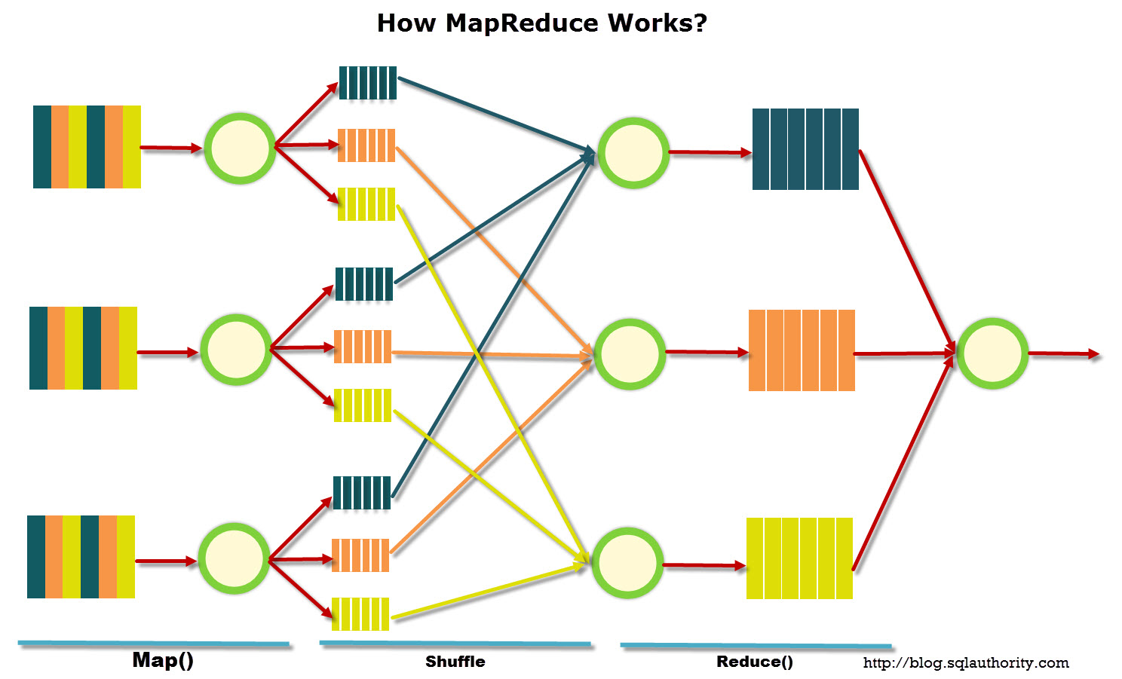
Map Reduce

Slide 10
db.runCommand(
{
mapReduce: <collection>,
map: <function>,
reduce: <function>,
finalize: <function>,
out: <output>,
query: <>,
sort: <>,
limit: <number>,
}
)
In a script: db,.<collection>.mapReduce(…)

Slide 11
Replication and Sharding
Replication in MongoDB
A replica set is a group of mongod instances that host the same data set. One mongod, the primary, receives all write operations.
All other instances, secondaries, apply operations from the primary so that they have the same data set.
Sharding in MongoDB
Sharding is the way MongoDB scales horizontally. A shard is a chunk of data stored by a MongoDB instance

Slide 12
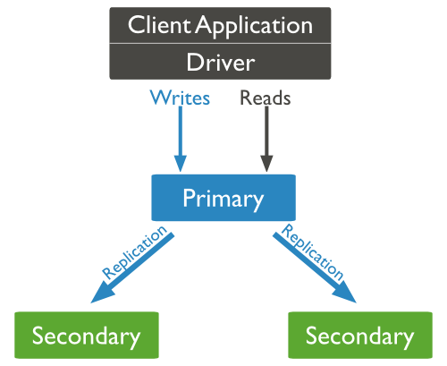
Replica Sets
Replica sets are a group of mongodb instances duplicating the same data
The minimum requirements for a replica set are: A primary, a secondary, and an arbiter. Most deployments, however, will keep three members that store data: A primary and two secondary members.

Slide 13
A replica set
Primaries hold the reference copy of the data
The secondaries replicate the primary’s log and apply the operations to their data sets.
Secondaries’ data sets reflect the primary’s data set. If the primary is unavailable, the replica set will elect a secondary to be primary.
By default, clients read from the primary, however, clients can specify a read preferences to send read operations to secondaries.

Slide 14
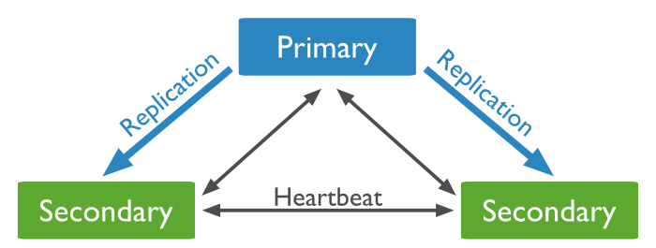
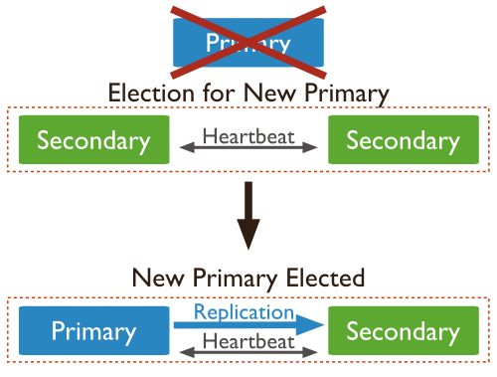
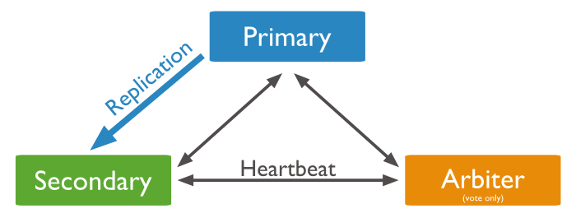
Functioning of a Replica Set
Failover, Arbitrer, Heartbeat
arbiter can only be an arbiter. A primary may step down and become a secondary. A secondary may become the primary during an election

Slide 15
Secondaries
The secondaries replicate the primary’s oplog and apply the operations to their data sets. Secondaries’ data sets reflect the primary’s data set.
If the primary is unavailable, the replica set will elect a secondary to be primary.
By default, clients read from the primary, however, clients can specify a read preferences to send read operations to secondaries. Reads from secondaries may return data that does not reflect the state of the primary

Slide 16
Asynchronous and Replication
In general, Secondaries could apply operations from the primary asynchronously.
By applying operations after the primary, sets can continue to function without some members.
However, as a result secondaries may not return the most current data to clients.

Slide 17
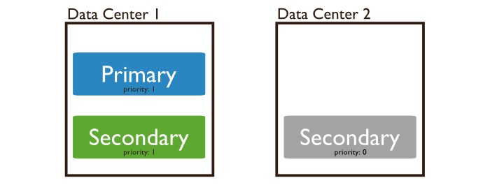
Priority 0 Replica Set Members
A priority 0 member is a secondary that cannot become primary. Priority 0 members cannot trigger elections.
A priority 0 member maintains a copy of the data set, accepts read operations, and votes in elections.
It is particularly useful in multi-data center deployments.
Prevent it from becoming a primary in an election, which allows it to reside in a secondary data center or to serve as a cold standby.

Slide 18
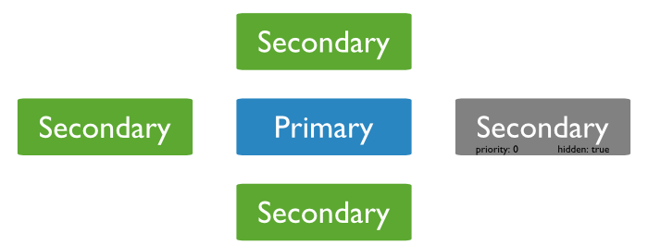
Hidden replica set member
A member of the replica set can be defined as hidden
Prevent applications from reading from it, which allows it to run applications that require separation from normal traffic.
Clients will not distribute reads with the appropriate read preference to hidden members.
These members receive no traffic other than basic replication. Use hidden members for dedicated tasks such as reporting and backups. Delayed members should be hidden.

Slide 19
Delayed Replica Set Members
Delayed members contain copies of a replica set’s data set.
Delayed member’s data set reflects an earlier, or delayed, state of the set.
For example, if the current time is 09:52 and a member has a delay of an hour, the delayed member has no operation more recent than 08:52.
Because delayed members are a “rolling backup” or a running “historical” snapshot of the data set, they may help you recover from various kinds of human error.
For example, a delayed member can make it possible to recover from unsuccessful application upgrades and operator errors including dropped databases and collections.
Keep a running “historical” snapshot for use in recovery from certain errors, such as unintentionally deleted databases.

Slide 20
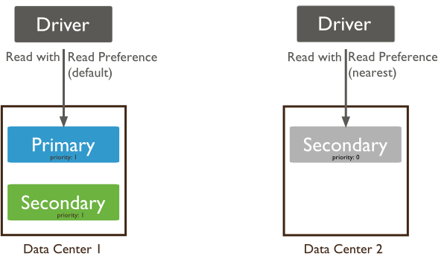
Read Preferences
Read preference describes how MongoDB clients route read operations to members of a replica set.
By default, an application directs its read operations to the primary member in a replica set.
Reading from the primary guarantees that read operations reflect the latest version of a document.
However, by distributing some or all reads to secondary members of the replica set, you can improve read throughput or reduce latency for an application that does not require fully up-to-date data.

Slide 21
Reasons for read preferences
Running systems operations that do not affect the front-end application.
Providing local reads for geographically distributed applications.
If you have application servers in multiple data centers, you may consider having a geographically distributed replica set and using a non primary read preference or the nearest. This allows the client to read from the lowest-latency members, rather than always reading from the primary.
Maintaining availability during a failover.
Use primaryPreferred if you want an application to read from the primary under normal circumstances, but to allow stale reads from secondaries in an emergency. This provides a “read-only mode” for your application during a failover.

Slide 22
Dangers
Using secondary and secondaryPreferred could be dangerous:
Because replication is asynchronous and there is some amount of delay between a successful write operation and its replication to secondaries, reading from a secondary can return out-of-date data.
Distributing read operations to secondaries can compromise availability if any members of the set are unavailable because the remaining members of the set will need to be able to handle all application requests.
For queries of sharded collections, for clusters with the balancer active, secondaries may return stale results with missing or duplicated data because of incomplete or terminated migrations.

Slide 23
Write Concern
Write concern describes the guarantee that MongoDB provides when reporting on the success of a write operation.
The strength of the write concerns determine the level of guarantee.
There are 4 levels of write concern
Unacknowledged
Acknowledged
Journaled
Replica Acknowledged

Slide 24
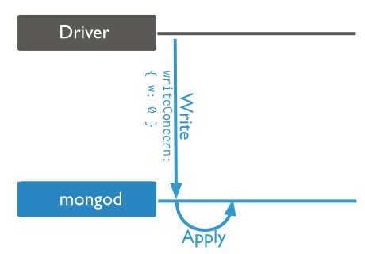
Unacknowledged
With an unacknowledged write concern, MongoDB does not acknowledge the receipt of write operations.
Unacknowledged is similar to errors ignored; however, drivers will attempt to receive and handle network errors when possible.
The driver’s ability to detect network errors depends on the system’s networking configuration.

Slide 25
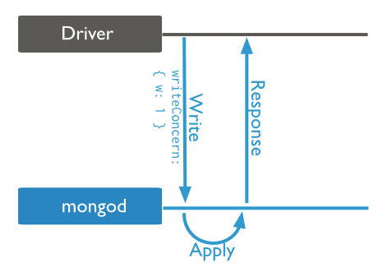
Acknowledged
With a receipt acknowledged write concern, the mongod confirms that it received the write operation and applied the change to the in-memory view of data. Acknowledged write concern allows clients to catch network, duplicate key, and other errors.
MongoDB uses the acknowledged write concern by default

Slide 26
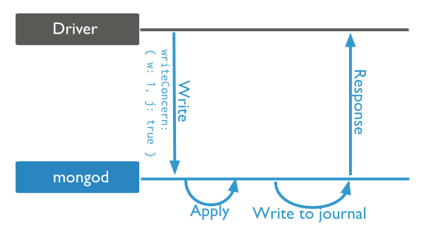
Journaled
With a journaled write concern, the MongoDB acknowledges the write operation only after committing the data to the journal.
This write concern ensures that MongoDB can recover the data following a shutdown or power interruption.
You must have journaling enabled to use this write concern.
With a journaled write concern, write operations must wait for the next journal commit. To reduce latency for these operations, MongoDB also increases the frequency that it commits operations to the journal.

Slide 27
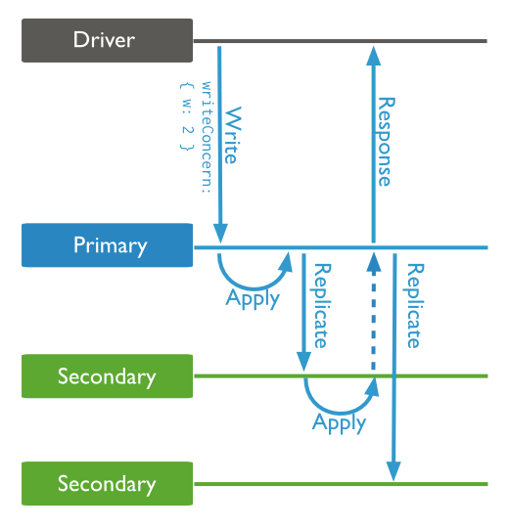
Replica Acknowledged
Replica sets present additional considerations with regards to write concern. The default write concern only requires acknowledgement from the primary.
With replica acknowledged write concern, you can guarantee that the write operation propagates to additional members of the replica set.

Slide 28
SHARDING IN MONGO DB

Slide 29
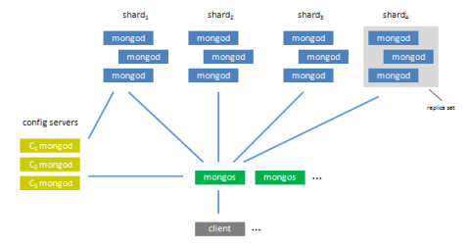
Sharding and Replica sets
Multiple config servers, each one holds a copy of the meta data indicating which data lives on which shard. mongod are the mongo servers
One or more routers (mongos), each one acts as a server for one or more clients. Clients issue queries/updates to a router and the router routes them to the appropriate shard while consulting the config servers.
One or more clients, each one is (part of) the user's application and issues commands to a router via the mongo client library (driver) for its language.

Slide 30
Sharding
1 Terabyte of data divided in 4 shards. Each shard is either a mongod or a replica set
Sharding is done at collection level

Slide 31
Components of a Sharded Cluster

Slide 32
Components of a Sharded Cluster /2
Shards store the data. To provide high availability and data consistency, in a production sharded cluster, each shard is a replica set.
Query Routers, or mongos instances, interface with client applications and direct operations to the appropriate shard or shards. The query router processes and targets operations to shards and then returns results to the clients. A sharded cluster can contain more than one query router to divide the client request load. A client sends requests to one query router.
Config servers store the cluster’s metadata. This data contains a mapping of the cluster’s data set to the shards. The query router uses this metadata to target operations to specific shards. Production sharded clusters have exactly 3 config servers.

Slide 33
Shard Keys
Indexed Field on which data are divided in chunk and assigned to each shard
Range based vs Hash-based vs tag-based Partitioning
Writing vs query using _id

Slide 34
Maintaining Balance Dataset
2 processes to assure balance dataset
Splitting, when the shard grows over a certain size
Background process, need to use the shard key to divide them. If the shard key is the same, it will not happen

Slide 35
Some Commands
sh.shardCollection("<database>.<collection>", shard-key-pattern)
Replace the <database>.<collection> string with the full namespace of your database, which consists of the name of your database, a dot (e.g. .), and the full name of the collection. The shard-key-pattern represents your shard key, which you specify in the same form as you would an index key pattern.
Examples
The following sequence of commands shards four collections:
sh.shardCollection("records.people", { "zipcode": 1, "name": 1 } )
sh.shardCollection("people.addresses", { "state": 1, "_id": 1 } )
sh.shardCollection("assets.chairs", { "type": 1, "_id": 1 } )
sh.shardCollection("events.alerts", { "_id": "hashed" } )

Slide 36
Shard Keys - Issues
When selecting the shard key, we want to preserve high write scaling and high query isolation
Write scaling issues
Ability to exploit parallel writing on multiple sharding. How is it affected when:
Using object-id without hashing
Using hashing
Querying isolation
Each query will be routed to ideally only 1 shard (or few shards). The mongos processes has to route the request
If the query does not use shard key all the shards has to be scanned
Which is better between the above 2?

Slide 37
Chose the right shard key
If your query includes the first component of a compound shard key, the mongos can route the query directly to a single shard, or a small number of shards, which provides better performance. Even if you query values of the shard key that reside in different chunks, the mongos will route queries directly to specific shards.
To select a shard key for a collection:
determine the most commonly included fields in queries for a given application
find which of these operations are most performance dependent.
If this field has low cardinality (i.e not sufficiently selective) you should add a second field

Slide 38
The importance of Cardinality
Cardinality in the context of MongoDB, refers to the ability of the system to partition data into chunks.
For example, consider a collection of data such as an “address book” that stores address records:
Consider the use of a state field as a shard key:
low cardinality
all documents that have the same value in the state field must reside on the same shard, even if a particular state’s chunk exceeds the maximum chunk size.
Since there are a limited number of possible values for the state field, MongoDB may distribute data unevenly among a small number of fixed chunks. This may have a number of effects:
If MongoDB cannot split a chunk because all of its documents have the same shard key, migrations involving these un-splittable chunks will take longer than other migrations, and it will be more difficult for your data to stay balanced.

Slide 39
The importance of Cardinality /2
zipcode field as a shard key:
higher cardinality,
In these cases, cardinality depends on the data. If your address book stores records for a geographically distributed contact list or more geographically concentrated
phone-number field as a shard key:
Phone number has a high cardinality, because users will generally have a unique value for this field
MongoDB will be able to split as many chunks as needed.
While “high cardinality,” is necessary for ensuring an even distribution of data, having a high cardinality does not guarantee sufficient query isolation or appropriate write scaling.

Slide 40
More Commands
To add a shard for a replica set named rs1 with a member running on port 27017 on
mongodb0.example.net, issue the following command:
sh.addShard( "rs1/mongodb0.example.net:27017" )

Slide 41
Setup a replica set
A replica set rs0 with 3 members.The replica set members are on the following hosts: mongodb0.example.net, mongodb1.example.net, and mongodb2.example.net.
For each member, start a mongod, specifying the replica set name through the replSet option.
mongod --replSet "rs0"
Repeat this step for the other two members of the rs0 replica set.
Connect a mongo shell to a replica set member. Connect a mongo shell to one member of the replica set
mongo mongodb0.example.net
3. Initiate the replica set. From the mongo shell, run rs.initiate() to initiate a replica set that consists of the current member.
rs.initiate()
4. Add the remaining members to the replica set.
rs.add("mongodb1.example.net")
rs.add("mongodb2.example.net")

Slide 42
Create some test data
Step 5: Create and populate a new collection. The following step adds one million documents to the collection. Issue the following operations on the primary of the replica set:
use test
var bulk = db.test_collection.initializeUnorderedBulkOp();
people = ["Marc", "Bill", "George", "Eliot", "Matt", "Trey", "Tracy", "Greg", "Steve", "Kristina", "Katie", for(var i=0; i<1000000; i++){
user_id = i;
name = people[Math.floor(Math.random()*people.length)];
number = Math.floor(Math.random()*10001);
bulk.insert( { "user_id":user_id, "name":name, "number":number });
}

Slide 43
The Balancer
The balancer can run from any of the query routers in a cluster.
When the distribution of a sharded collection in a cluster is uneven, the balancer process migrates chunks from thevshard that has the largest number of chunks to the shard with the least number of chunks until the collection balances.
The shards manage chunk migrations as a background operation between an origin shard and a destination shard.

Slide 44
The Balancer /2
During a chunk migration, the destination shard is sent all the current documents in the chunk from the origin shard.
The destination shard captures and applies all changes made to the data during the migration process.
Finally, the metadata regarding the location of the chunk on config server is updated.
If there’s an error during the migration, the balancer aborts the process leaving the chunk unchanged on the origin shard. MongoDB removes the chunk’s data from the origin shard after the migration completes.

Slide 45
A Sharded Cluster Architecture

Slide 46
Sharded and not shared collections
Why some collections are not sharded?
What about reliability?

Slide 47
Config Servers
Config servers are special mongod instances that store the metadata for a sharded cluster.
A production sharded cluster has exactly three config servers. All config servers must be available to deploy a sharded cluster or to make any changes to cluster metadata. Config servers do not run as replica sets.
Config servers store the cluster’s metadata in the config database. The mongos instances cache this data and use it to route reads and writes to shards.
MongoDB only writes data to the config server when the metadata changes, such as
after a chunk migration or
after a chunk split.

Slide 48
When to shard
While sharding is a powerful and compelling feature, sharded clusters have significant infrastructure requirements and increases the overall complexity of a deployment. Use it only if needed
Usually, these are the application and operational requirements
Use sharded clusters if:
your data set approaches or exceeds the storage capacity of a single MongoDB instance.
the size of your system’s active working set will soon exceed the capacity of your system’s maximum RAM.
a single MongoDB instance cannot meet the demands of your write operations, and all other approaches have not reduced contention.

Slide 49
Architecture of a Production Cluster
In a production cluster, you must ensure that data is redundant and that your systems are highly available. To that end,a production cluster must have the following components:
Three Config Servers Each config server must be on separate machines. A single sharded cluster must have exclusive use of its config servers. If you have multiple sharded clusters, you will need to have a group of config servers for each cluster.
Two or More Replica Sets As Shards. These replica sets are the shards.
One or More Query Routers (mongos) The mongos instances are the routers for the cluster. Typically, deployments have one mongos instance on each application server.

Slide 50
Architecture: production vs test
Production
3 config servers (3 different machines)
Many routers
Many shards implemented as replica set
Test
At least 1 config server
At least 1 router
At least 1 shard (even a mongod instance)

Slide 51
More on Sharding
Sharding is the partitioning of data among multiple machines in an order-preserving manner.
Sharding is performed on a per-collection basis.
Each shard stores multiple "chunks" of data, based on the shard key. MongoDB distributes these chunks evenly.
In MongoDB, sharding is the tool for scaling a system, and replication is the tool for data safety, high availability, and disaster recovery.
The two work in tandem yet are orthogonal concepts in the design.
MongoDB's auto-sharding scaling model shares many similarities with Yahoo's PNUTS and Google's BigTable.

Slide 52
More on Sharding
A chunk is a contiguous range of data from a particular collection.
Chunks are described as a triple of collection, minKey, and maxKey.
Thus, the shard key K of a given document assigns that document to the chunk where minKey <= K < maxKey.
Chunks grow to a maximum size, usually 64MB.
Once a chunk has reached that approximate size, the chunk splits into two new chunks.
When a particular shard has excess data, chunks will then migrate to other shards in the system.
Balancing is necessary when the load on any one shard node grows out of proportion with the remaining nodes.
In this situation, the data must be redistributed to equalize load across shards.

